Slide 1



self-X Artificial Intelligence
for European Process Industry digital transformation
This project receives funding in the European Commission’s Horizon Europe Research Programme under Grant Agreement Number 101058715

Slide 2
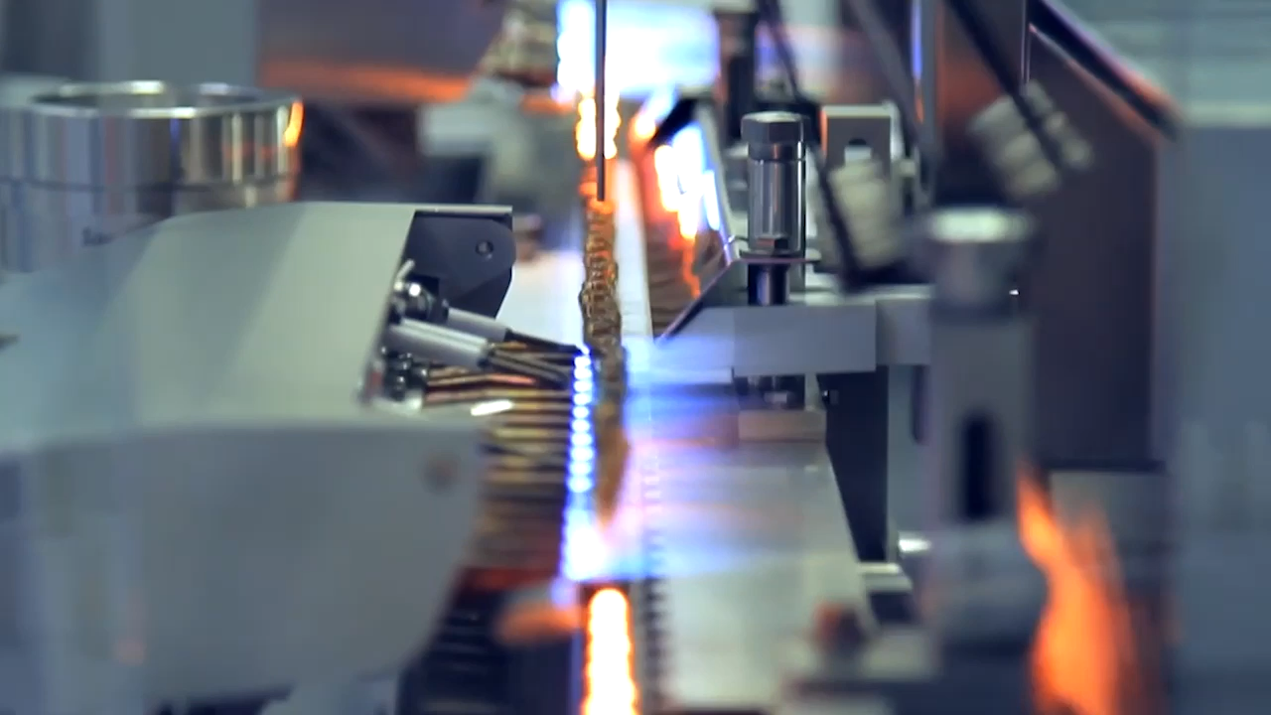
These applications will not only minimise human involvement in the loop but will also exhibit self-improving capabilities.
s-X-AIPI is a Horizon Europe Project that will research, develop, test, and experiment on, an innovative toolset of custom and trustworthy self-X AI technologies for the process industries.

Slide 3


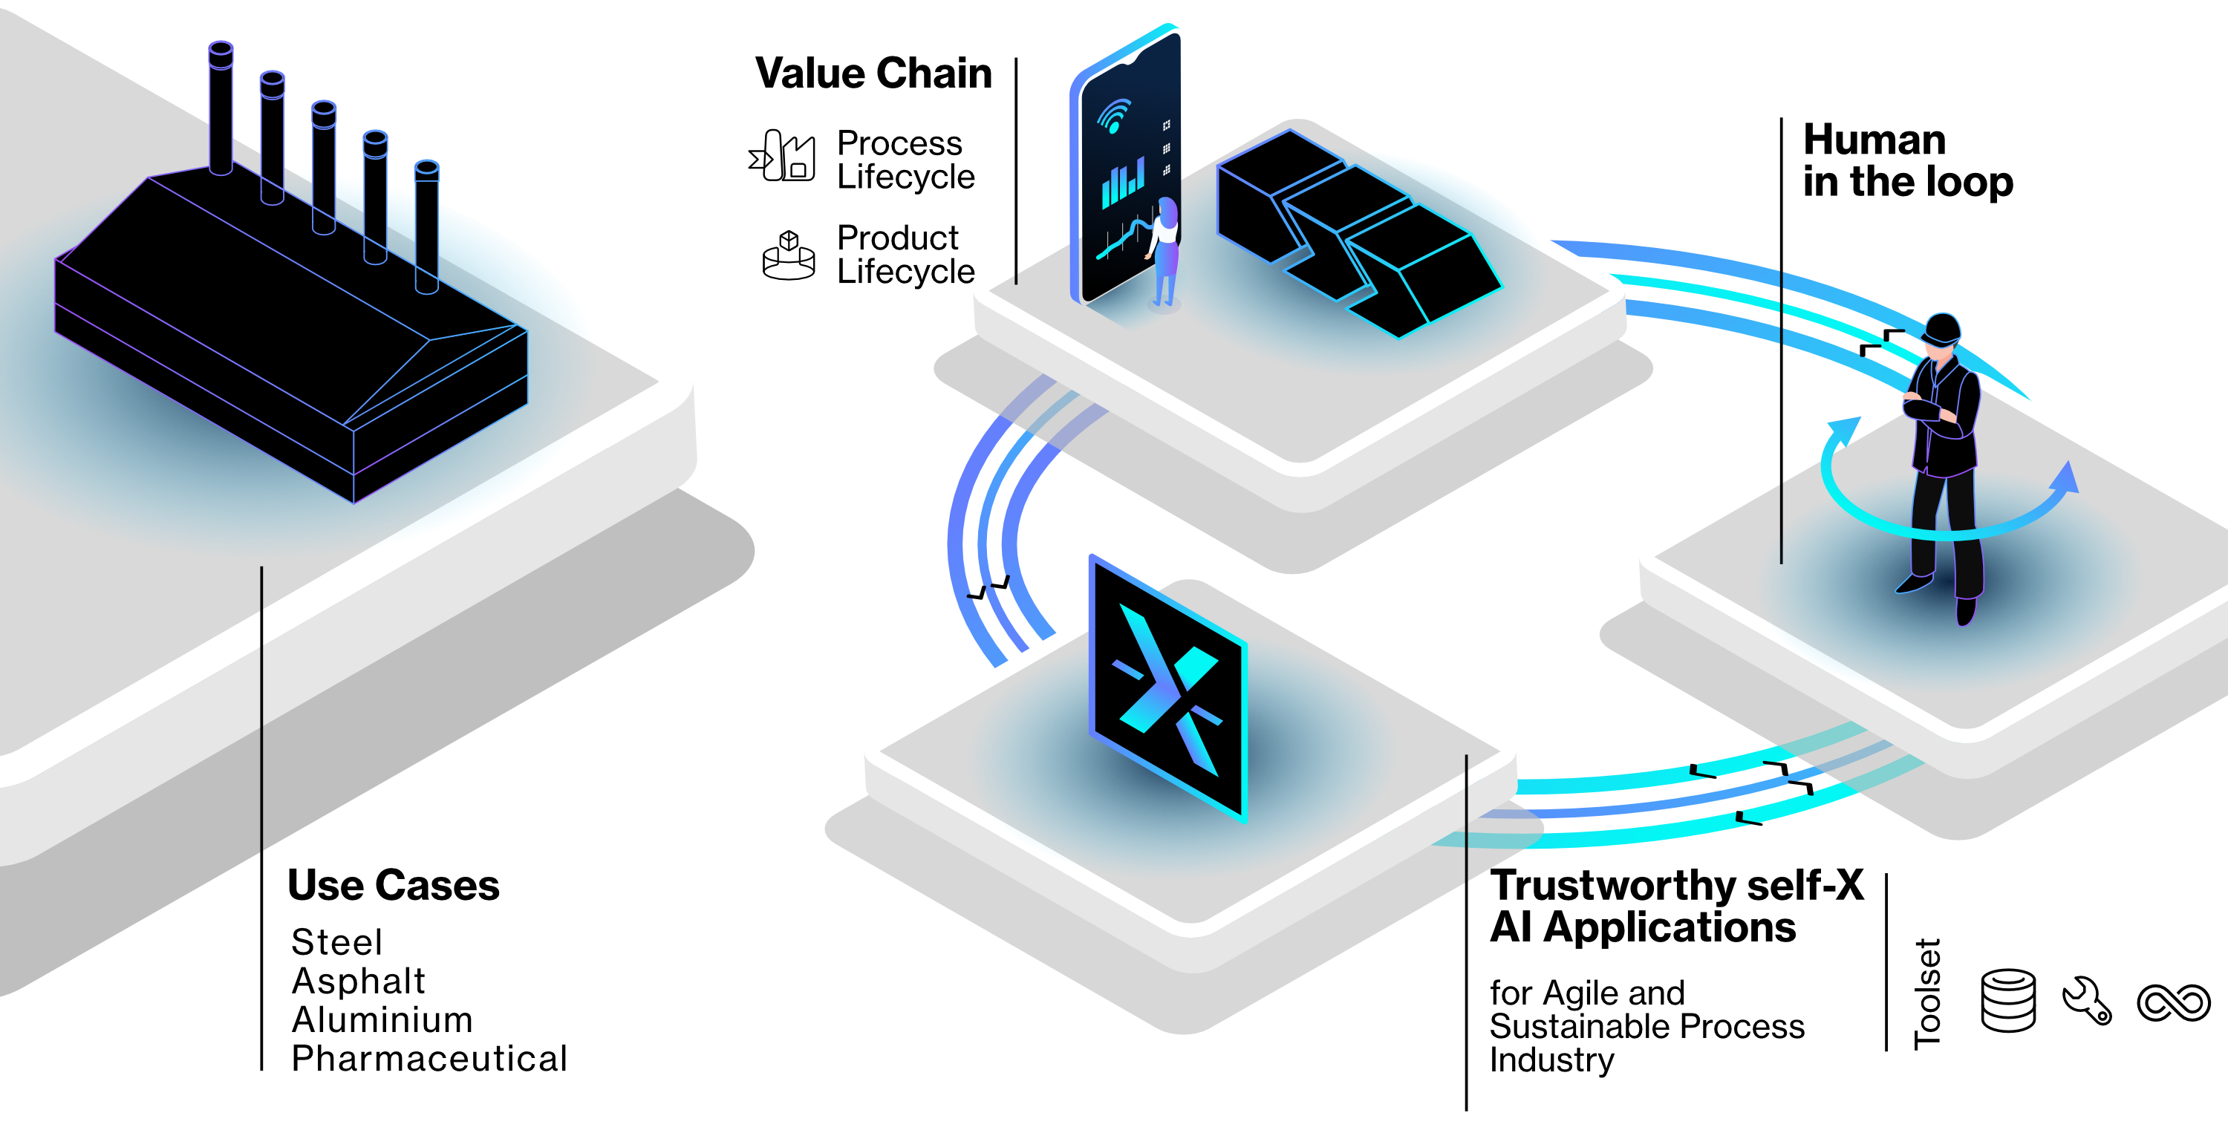

Slide 4
Our Mission
The s-X-AIPI toolset of AI technologies aims to offer more simplified interfaces that:
Will require less specialised maintenance.
Will have longer useful life.
Will not require a highly skilled workforce.

Slide 5
Both existing process industries and their workforce will be equipped with
Operational agility
Performance Optimisation
Cutting-edge AI-based tools

Slide 6
Cutting-edge Technology

Slide 7

Cutting-edge technology
An innovative AI data pipeline
AI applications continually updated (self-improving abilities) by integrating data with reduced human intervention.
Autonomic Manager supporting human in the loop roles.
with autonomic computing capabilities (self-X AI and autonomic manager)

Slide 8
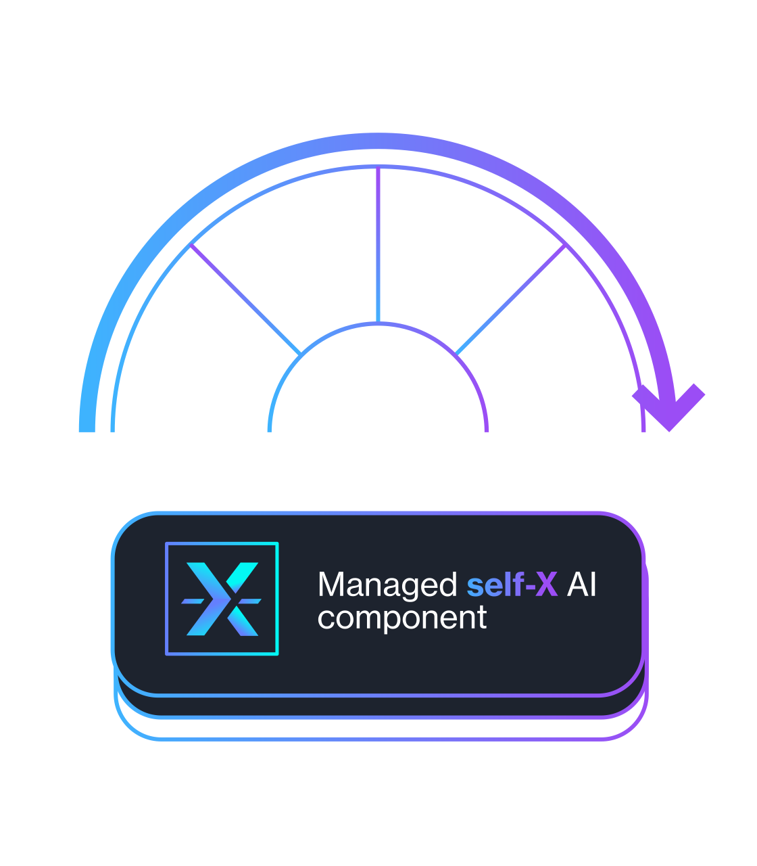
Cutting-edge technology
Self-X AI represents the fusion of AI as the intelligent processing system and an Autonomic Manager (proposed by IBM), based on the MAPE-K model.
This model encompasses a continuous cycle of Monitoring, Analyzing, Planning, and Execution—flow based on the Knowledge of the AI system under control. This synergy will result in the development of self-improving AI systems.

Slide 9
Self-X AI represents the fusion of AI as the intelligent processing system and an Autonomic Manager (proposed by IBM), based on the MAPE-K model.
Cutting-edge technology
This model encompasses a continuous cycle of Monitoring, Analysing, Planning, and Execution —flow based on the Knowledge of the AI system under control.

Slide 10
Asphalt, steel, aluminium, & pharmaceuticals
Use Cases
4 representative industrial use-cases will be implemented, validating the potential of the developed AI technologies in real-world scenarios.

Slide 11

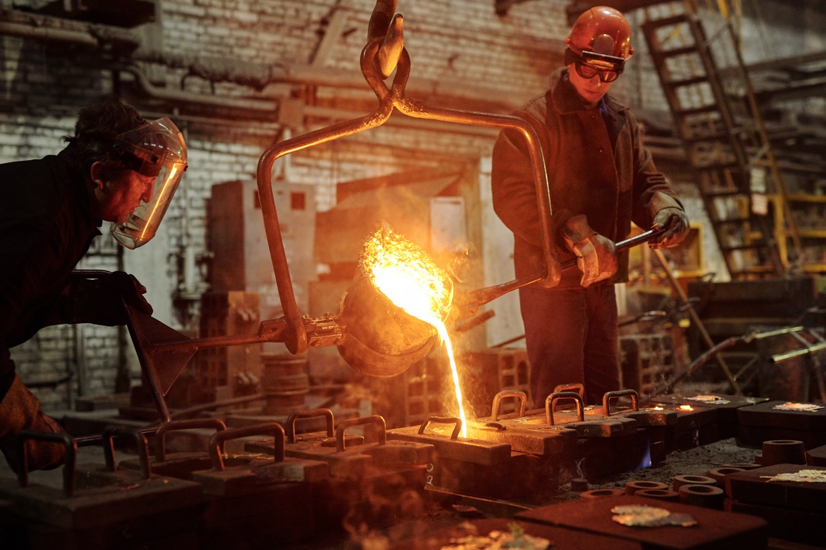
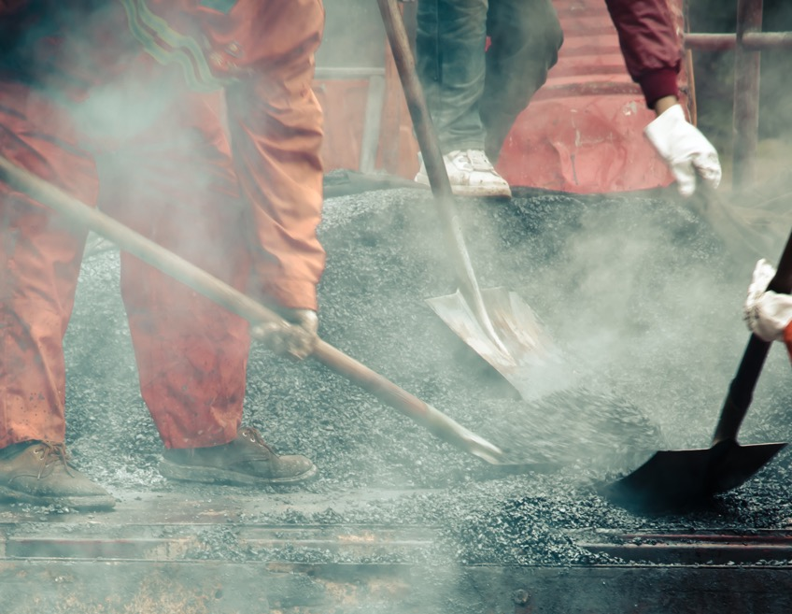
Steel use-case
Focuses on optimising the use of scrap to produce high-quality steel products, while avoiding downstream surface quality problems and reducing process energy intensity.

Slide 12
User Scenarios Description and Expectations
Objectives/Benefits
  Tighter supervision of scrap suppliers
  Support for enhanced usage of low-cost scrap types
  Improved process end-point control
  Homogeneous production by shared knowledge
Current Situation
  Raw materials make up 70 – 90 % of production cost and energy consumption 10 – 15 %
  Uncertainty in scrap properties makes optimal operation difficult
  Stand-alone software tools require a lot of human intervention and supervision
    Scrap Supervision
    Scrap Mix Optimization
    End-point control prediction
Notes:
The improved control of varying steel scrap properties allows:
Tighter supervision of scrap suppliers
Support for enhanced usage of low-cost scrap types
Improved process end-point control
Homogeneous production by shared knowledge
Therefore, the s-X-AIPI project is proposed for improving:
The control in the plant by using Machine Learning for calculating the scrap chemical composition, which is normally affected by disturbing elements like copper, sulphur or phosphorus, considered as residual elements which downgrades the steel quality, and with high degree of uncertainty.
The scrap mix that minimizes the cost and meets the customer requirements in terms of liquid steel chemistry.
Assure the best performance of the process for achieving the required steel temperature and chemical composition.

Slide 13
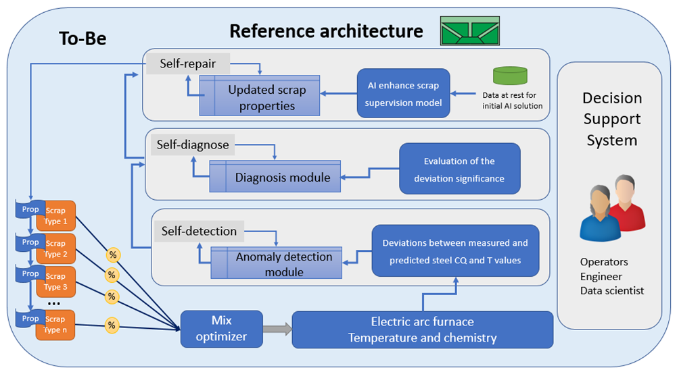
To-be scenario
Human roles interacting with self-X solutions
Monitor performance of AI tools via HMI
Web UI as HMI with autonomic manager
Final decision done by human
Notes:
The steelmaking process in a future that is envisioned by the s-X-AIPI project still involves the operator taking decisions about machine set points, loading material and chemistry control. However, contrary to the current situation the developed support system will provide Operators with insights about the scrap properties and furnace temperature and chemistry. The envisioned self-X solution will monitor the input and output data space to detect unexpected events or drifting of the tools’ accuracies and propose corrective actions to regain and maintain the robustness of the system. Overall, the goal is to ensure resilience and accuracy on the temperature and chemistry of steel at the
end point of the furnace treatment.
Human roles interacting with self-X solutions
The goal of the system developed for the steel use case will be to facilitate the interaction of the operators,
engineers and data scientist with the different modelling tools via a single interface to the autonomous manager
The role of the human interacting with the self-X solution will be as follows:
The enhance scrap supervision model will improve the available information on scrap properties which is key information for Scrap yard Operators. The accuracy of the model is envisaged to be high, therefore the feedback of Operators in the loop on the safety coefficients to be included into the code will be relevant.
The knowledge about the prediction on the status of the chemistry and temperature at the ending of the furnace step will serve as a guideline for Furnace Operators. The feedback on the reliability of the prediction under operation will serve to improve the ML calculation.
The autonomous manager will serve to data scientist to a studio of model independence. Thus, the autonomous manager will serve information about self-X-detection and diagnosis of anomalies during the process and give a suggestion of self-X-repair to data scientists.
The role of operators will be mainly to use the visual information as decision making support, while engineers or data scientist will have additional configuration possibilities

Slide 14
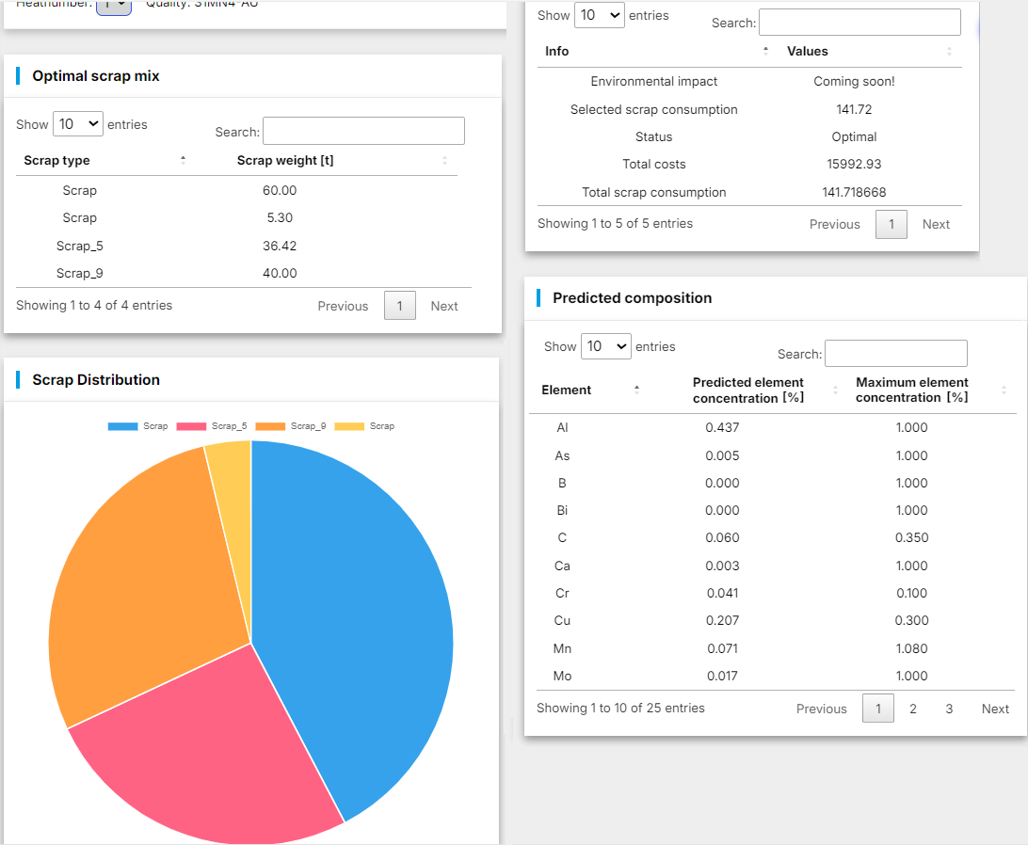
Scrap mix optimization
Optimal charge material mix
Product quality
Costs
Notes:
For determining the optimal charge material mix in terms of product quality and costs a Decision Support System was developed by BFI.
For each steel grade to be produced, the developed tool determines the optimal charge mix, consisting of different scrap types and alternative iron sources.
It considers the purchase costs of the materials, but also the costs for electrical and chemical energy sources to melt down the materials, and their availability, either on the plant's internal scrap yard or on the market. Figure shows the result of the calculation for an example steel quality

Slide 15
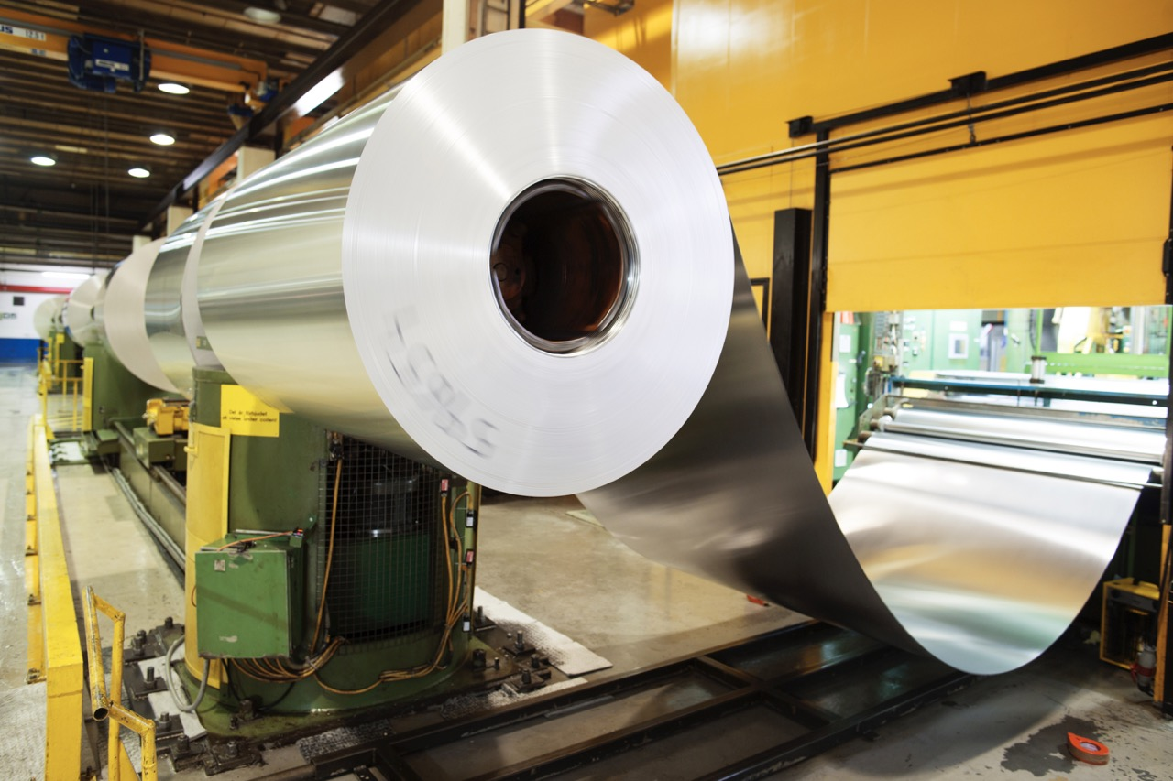
Aluminium
use-case
Focuses on optimizing recycling processes from scrap, reducing the melting power on time, optimizing metal yield, and improving liquid aluminium quality leading to a decreased rate of downstream quality rejections.

Slide 16
Who are we?
A consortium of 14 partners from 6 countries

Slide 17




Join us
WEBSITE
EMAIL
LINKEDIN
X (former Twitter)
www.s-x-aipi-project.eu
s-X-AIPI@cartif.es
S-X-AIPI
@S-X-AIPIPROJECT

